Slide 1
October Conference
Biomedical Libraries at Dartmouth College
October 9, 2009
Staff Development
on a Shoestring
Notes:
Jane and I are very pleased to be invited to be with you today.
We’re all facing shoestring budgets, and sometimes there isn’t much left of the string…
CLICK

Slide 2
Training Library Assistants for
New Roles
Jane Fama
Associate Director, Operations
Barbara Ingrassia
Associate Director,
Strategic Initiatives and Work Force Development
The Lamar Soutter Library
University of Massachusetts Medical School
Worcester, MA
Notes:
We want to share some ideas about how we’ve held on to the STRING at UMass Med School. And we’re eager to learn from you all as well.
We have a lot we’d like to share, and time does not permit, so we have included extra handouts and our contact info.
We’ll be happy to take questions at the end—or contact us.
CLICK

Slide 3
Why a new training program?
Why now?
Respond to:
Budget cuts
Changes in technology
Changing needs of our patrons
Our response:
Develop a cross-training program for Support Staff
Notes:
We don’t need to dwell on defining these terms---and they seem to be coming all at the same time.
Budget cuts reduce staff and remaining staff must do more with less—more efficiently.
Tech changes provide more options, but there’s a learning curve. Those new capabilities affect both staff and patrons.
Our Patrons are accessing resources remotely; there is less face-to-face contact with staff
The Rules are changing…and the roles need to change as well.
How did we respond to those changes?
CLICK
By developing a cross-training program for support staff
It took 2+ years to develop, and was launched in Sep 2007
CLICK

Slide 4
Benefits of a formalized program
For the Library:
Better positioned for our future in a changing information environment
Flexible resources—knock down the “silos”
Staff with even more skills
For Library Assistants:
Evaluation criteria detail clear and consistent expectations
Particularly helpful for New Staff
Part of a Career Ladder Program
Notes:
There were benefits for all parties involved, as you can see:
The Library could be up-to-date on new technology and services and thus better serve our patrons.
Our staffing could be more flexible. We could knock down the silos of Public Services vs Tech Service. “That’s not my job”…. “I don’t know how so I can’t step in.”
As we’ll see later in Jane’s presentation, that flexibility applied to the librarians as well.
We needed to cross-train staff so they could step in where needed. (In retrospect) This has been PARTICULARLY helpful as we plan for service continuity in the case of extensive staff absences due to any sort of flu or other illness.
FOR THE STAFF:
Clear evaluation criteria let them know exactly what they needed to be able to do.
This was particularly helpful for the training and orientation of NEW STAFF and we could prepare existing staff for new roles as their former duties were cut back or eliminated (e.g. binding in a library going e-only.) This gave them more skills.
And, as a part of the Career Ladder Program, gave them the opportunity for promotion and advancement.

Slide 5
The Training was arranged around these
4 Areas of Responsibility
Public Desk - Circulation, Ready-Reference, Single Service Point
Interlibrary Loan - Borrowing/Lending/Loansome Doc
Resource Management - Acquisitions, Copy-Cataloging, Serials Processing, Stacks Maintenance
Technology Support + Initiatives – Technology Support, Web Page, Technology Initiatives (e.g.: The eScholarship IR)
Notes:
We evaluated the library’s support service functions and grouped them as you see here into 4 AREAS of RESPONSIBILITY.
This will evolve as the factors we mentioned earlier evolve.

Slide 6
Training was divided into:
Basic Skills Sets
  Functional Job Skills
  Library Basic Skills
  Team Skills
  Microsoft Office Skills
Notes:
Now to the MEAT: The actual training:
We divided the training topics into 4 areas, as you see here
The functional job skills are for the 4 areas listed on the previous slide. Jane will talk about that training process in more detail.
The other 3 I’ll describe in the next few slides

Slide 7
Training Methods
  Combination of:
    Classes—
    Developed and delivered by:
      LSL Staff -- primarily
      UMMS Human Resources
        Your Customer is Upset
        Communication skills
      UMMS Diversity & Equal Opportunity Office
        Various policies
      UMMS Information Systems
      Consortia Groups
    Hands-on
    Independent Study
  Study time was allotted in staff work schedules, as needed.
Notes:
We used a variety of training methods, depending on the skill or topic.
Classes
Hands-on
Independent Study
The classes were developed and taught primarily by existing library staff. It was my job to coordinate that process. I taught many of them; better qualified staff taught some of them.
HR did help with some customer service training.
DEOO helped explain policies
IS provided classes on the MS 2007 upgrade, but usually I attended classed and then developed training for library staff
We identified our consortia groups as possibilities, but to date have not utilized those in this program
Hands-on training was particularly impt for functional duties and MS programs
Independent study allowed for reading, practice, and review.
Some training was in groups, some was one-on one. Staff members were given time for reading, practice, etc.

Slide 8
Evaluation
  Each duty has evaluation criteria
  Ongoing to track progress
  Pass/Fail
  Opportunity for re-evaluation
  Maintain portfolio of their training materials and evidence of progress
Notes:
We needed to know if our training methods were working—were they effective,
So each duty had a set of measurable evaluation criteria; there were “certification exercises” of various types---which I’ll get into in a minute.
Each skill or duty was evaluated as it was learned; there was no big FINAL EXAM at the end of a section.
It was all pass/fail---always opportunities to try again. We wanted staff to LEARN and SUCCEED
And they maintained a portfolio of requirements and progress.

Slide 9
Evaluation Methods
  Case Study
  Observation—”Real Time,” “After the Fact”
  Role Playing
  Written Assessment
  Self-Evaluation
  Customer Evaluation
  The specific evaluation technique depends on the type of skill being assessed: behavioral, process, or knowledge-based
Notes:
These were some of the evaluation techniques we initially identified, but we have not used all of them to date.

Slide 10

Area of Responsibility – Public Desk
Achievement Stage | Duties | Evaluation Criteria
Developing | Can describe differences between databases and when appropriate to use each PubMed, CINAHL (OVID), InfoTrac(Expanded Academic ASAP) | When given a list of research/clinical questions, will identify most appropriate database to search and perform basic searches with 95% accuracy.
Accomplished | Performs Advanced Searches in QUIN, PubMed, OVID, InfoTrac | Use search strategies and navigation tabs to search complex requests to retrieve information. Observe using features to help focus searches such as Boolean operators, limits, and truncation to present results.
Mastery | Stays up-to-date with new resources and vendor enhancements to electronic resources | Will receive emails from principal vendors (i.e. Thomson, OVID, etc), subscribe to one listserv, read technical updates from NCBI, use RSS feeds and attend in-house training classes as well as local professional meetings. (case study and observation)
Necessary skills or competencies increase at each achievement stage.
Notes:
This is an example of one of the Areas of Responsibility—in this case PUBLIC DESK---
With some of the duties and evaluation criteria.
And you can see how the duties/responsibilities become more complex—how the staff is growing in their skills

Slide 11
Public Desk
Area of Responsibility: | Public Desk
Achievement Level: | Developing
Duty | Evaluation Criteria
Customer Service Knows populations served and the different levels of access to library services & resources Can describe access policies regarding resources and services available to patrons Can describe library policies and procedures to patrons Uses proper protocol when answering the phone. Is courteous, listens to patron inquiries and is responsive. Knows location of library staff and offices for Medicine, GSBS and GSON Is familiar with library classes offered and can direct patrons to website descriptions and registration | Correctly classifies patron groups and access privileges 90% of the time (written assessment) When given an access situation, will respond correctly 90% of the time (written assessment) Given a scenario, can identify and apply the policy to the patron’s need. (role play) Will use the LSL prescribed script consistently (observation) Consistently has good interactions with patrons (observation) Can correctly identify locations with 100% accuracy. (written assessment) Can locate class descriptions and registration process for library classes. (observation)
Circulation Procedures Performs basic functions in Voyager Circulation Module: charge, discharge, renew Can register patrons Can locate patron by name, barcode, edit record, find what patrons have borrowed and when due in Voyager Patron Perform item search in Voyager Know how to determine if item is missing, overdue, or lost | When given 20 different types of items, can charge, discharge, renew and resolve problems with 95% accuracy. Can identify form and follow registration guidelines (observation) Given patron name, will locate barcode number, edit record, detail items borrowed and due date. When given a task to look for 20 items, can perform the search by author, title, or call number. Can identify the barcode and history of item with 95% accuracy. When given a list of 20 items or patron names, be able to determine the status of an item and how to proceed with 95% accuracy.
Notes:
Here is an actual page from the first stage (DEVELOPING) for Public Desk.
You see
Duties and their evaluation criteria under:
Customer service
Circulation procedures

Slide 12
Public Desk cont…
Patron Questions Can identify the type of question(s) from the patron: informational, directional, ready reference, reference, referral, follow-up Conduct a basic reference interview. | Given a list of questions, will be able to recognize ready-reference and in-depth questions. (written assessment) Be able to ask open ended questions and identify the information needed. (role play)
Locating/Maintenance Physical Library Materials Be familiar with basics of the shelving system using LC and NLM classification systems Shelve items according to their format Identify location & answer basic questions describing physical facilities available to patrons Be able to direct patrons to and/or locate: Reference materials and books that circulate Journals – bound, unbound, current & 8th floor holdings AV materials (and understand their arrangement) Consumer health materials and describe shelving organization | Can briefly describe each system and locate handout/file describing them. Earn a certificate from Shelve-it! (Basic skills assessment) Shelve 50 items per hour with 98% accuracy. (observation) Identify the physical areas of the library (written assessment) Given a blank map of the library, will locate all material collections with 100% accuracy. When asked, will be able to describe AV material arrangement and shelving organization for consumer health materials.
Electronic Resources Website: Knows how and when to use resources on website: QUIN, Online journals & books, MedlinePlus, Go Local Massachusetts, eMental Health, Encyclopedias, Newspapers, Dictionaries, Grammar & Writing, Biographical Resources, General Reference Sites | Can locate and describe each resource listed and appropriate use with 95% accuracy. (written assessment, observation)
Notes:
And a continuation of PD
And here:
Patron questions
Location/Maintenance of physical library materials
Electronic resources

Slide 13
Public Desk cont…
Databases Can Identify parts of the citation: author, title, journal, volume, issue number, paging and year Perform an author search, subject/keyword search Can describe differences between databases and when appropriate to use each PubMed, CINAHL (OVID), InfoTrac(Expanded Academic ASAP) | When given a list of citations, will be able to identify author, title, journal volume, issue number, paging and year with 95% accuracy. (basic skills assessment) Perform basic searches using author names, subject and/or keyword in PubMed, CINAHL, PsycINFO, etc. (written assessment) When given a list of research/clinical questions, will identify most appropriate database to search and perform basic searches with 95% accuracy.
Basic Library Public Equipment Direction and Information Is familiar with: Laptops PDAs Copy machines Printers Work stations | Laptops: identify and insert all external parts, log-on, know how to answer questions regarding wireless service (role play, observation) Can troubleshoot equipment, knows appropriate person to call and can document problem. (role play)
Open/Close Library Demonstrates preparing the library for opening and closing: turning on or off computer, locking or unlocking cabinets, keeping statistics of the gate, walking around the library alerting everyone the library will be closing, make sure all patrons are out of the library before locking the door. Knows the alarm procedure | Can perform all activities listed in the Opening/Closing procedures (observation) Knows who to call in emergency (both library staff and school). (role play) Is able to operate controls on the alarm box (observation)
Word | Basic
Excel | Basic
Power Point | Basic
Access
Internet Explorer | Basic
Windows | Basic
Teams | Basic
Skills | Successfully completes program
Skill
Sets
Notes:
Basic Library Public Equipment/ Direction and Information
Open/Close the Library
There are similar charts for “Accomplished” and “Mastery” ---the other 2 stages in the Career Ladder
Jane will go into much more detail on these,
But what I’d like you to notice is the box at the bottom labeled: Skill Sets
These are skills that we felt all staff should know, and for consistency and mutual feedback, they should be addressed in a group.
I want to look at those right now

Slide 14
Methods: Supervisor, Libn-hands-on, PPt
Methods: Supervisor, Library Employee Handbook, FAQ, (new staff intranet tools)
Methods: Formal team training, HR customer service. Video: “Give ‘em the Pickle”, Articles from Director in Staff newsletter, Intro to Levels Plan, notification of appropriate classes, Handout “Library Jargon” and asked staff to review/correct/add
Methods: Guest Speakers, Library Employee Handbook, PPt intro and discussion of Disaster Plan in Staff meeting
Notes:
You have this as a full-size handout in your packet
You can see the topics we wanted to cover and the types of training methods we used. Some skill sets required several sessions. Some just one. Attendance was required, but there were no formal evaluations. In fact, in these areas, we welcomed input and suggestions for content from existing staff
In the intro to the school, I covered in a PPt such things as:
Campus layout
What buildings contained what depts; out-of-town programs
A bit of history of the schools and sub-depts and degrees awarded
Overview of coursework and schedules
Areas of research
Library Culture: several different sessions to cover all this
how do teams work?
Customer service
Expected standards
What is the career ladder program
How are things changing for libraries?

Slide 15
Methods: Demo + Hands-on
Methods: Systems +Cataloging present PPt and Demo + Hands-on
Methods: Self-paced online module, PPt, Hands-on
Methods:
Demo + Hands-on
Methods: PPt, Hand-out, Tour + Demo
Notes:
And here are 5 more.
Various staff were involved in the training.

Slide 16
Team Training
Formal, one-session meeting:
  Definition of teams
  Benefits of team work
  Team structure
  Roles: Leader, Member, Champion
  Characteristics of effective teams
  Evaluating
How teams function at the LSL
Become a member of a team
Notes:
Much of the work of the Library is done in cross-departmental teams; that has been the case since 1998.
Here you see that the training is a formal class, including info about how teams work at the Library, and then, finally, the best training—very hands-on : being a member of a team
Any time we’re considering a new service – or changing a service—there may be a team or series of teams-- formed:
A study team
A planning team
An implementation team
Later a review team
Each has a specific charge/goal and a “deliverable”: usually a report with recommendations.
These have been applied for the web site, link resolver, new copiers/printers, the Single Service Desk ----that you’ll hear about from Jane.
Teams may last 3 months—6 months—9 months (usually) or be on-going. Some are open to volunteers, some are appointed.

Slide 17
Microsoft Skills: As needed by each AR
MS Access
MS Excel
MS Internet Browser
MS PowerPoint
MS Windows
MS Word
© 2009 University of Massachusetts
Notes:
WHY do this training?
Over the years, various MS skills have become essential for the successful completion of our job duties.
The Public Desk staff members need to be able to assist patrons
Self-development, personal continuing education and growth
During this first round of training, MS 2007 was introduced and installed---so some re-training was required.
Not everyone needs every skill at the same level, of course, but they may need at least a familiarity with several of them.
Training methods used:
Demo/hands-on classes/hand outs
One-on-one sessions
EVALUATION:
Written test using the MS skill (see the sample WORD test in your packet)
In the case of PPt, they produced a PPt program about some facet of their work. With the intent that it could be used for training other or New staff. (e.g. Procedures for Opening the Library, what a citation is and how to use it for ILL, barcoding bound journals)

Slide 18
Notes:
Here’s a view of the skills chart for WORD.
The assignment to a skill level was an educated guess based on materials from a published program. We have had to tweak them. Not every job function needs every skill—or at every level of proficiency. We do not expect to use “Expert” even for the Computer Technology area of responsibility.

Slide 19
      Microsoft Word: Basic Skills Test
      (INSTRUCTIONS HANDED TO PARTICIPANT before the test)
      Name: _________________________
      You will have 45 minutes to complete the proficiency test.
      The purpose of the test is to evaluate your skill level in Microsoft Word. There are two parts to the test.
      Part 1 is to create an electronic file following the instructions below. Part 2 is to respond to some short answer
      questions.
      Part 1
      Instructions: Using the electronic file, WordBasicStart.doc, edit the document to look like the two page
      handout you have received as part of this test. Some of the text you will need is in your starting document.
      Remember, you are creating one file with two pages. Save the file as your name Word.doc, e.g., Cathy Word.doc.
      Print the document, IN COLOR, to be handed in with Part 2.
      Tips
      *Watch for text that you can move or reformat instead of retyping. *You may have to delete text.
      *Select your font size and type as you think appropriate. *Use a one inch margin.
      *Don’t forget the footer. *Don’t forget the page numbers.
      *Select any image you like for the flyer on page two of your document.
      Part 2
      A. Using Microsoft HELP, name two sources for importing a picture.
      B. Using the thesaurus function, name two synonyms for book.
      C. Name one benefit of “Previewing” a document.
      D. What does the Save As function do?
      Here is the content of the STARTING DOCUMENT FOUND AT WordBasicStart.doc
      However, given that the data was 7 months old and that many libraries were considering products, the team concluded
      that a survey to the entire AAHSL discussion list would be useful and appropriate for asnwering the remaining two
      questions in our charge. The Management Team recommended that the team limit the survey to the libraries identified in
      the AAHSL preliminary survey results as already having access to a federated searching product. That survey showed 4
      1 libraries using federated searching, but one library responded to say there had been an error and they did
      not use it, leaving 40 libraries surveyed. The link to the survey was emailed on March 21, 2007, with a follow-up
      sent on April 3, 2007. The survey generated 17 responses, for a 42% return rate.
      These prelliminary survey results helped answer two of the questions in the team’s charge:

Slide 20
41 of 125 (33%) libraries currently have a federated searching product.
2 of 125 (1%) are planning to discontinue their current product.
11 of 125 (8%) are planning to add a federated searching product.
Metalib is the most popular product with 25 installs.
Percentages for libraries considering and not considering federated searching cannot be computed
because libraries selected multiple products.
These preliminary survey results helped answer two of the questions in the team’s charge:
Which of the AAHSL libraries are using a federated searching tool?
Which federated searching tools are medical libraries using?
However, given that the data was 7 months old and that many libraries were considering products,
the team concluded that a survey to the entire AAHSL discussion list would be useful and appropriate
for answering the remaining two questions in our charge.
Basic WORD Certification Exercise:
HANDOUT TO PARTICIPANT: FINAL PRODUCT SHOULD LOOK LIKE THIS (page 1)
Table 2: Summary of AAHSL Supplemental Survey Federated Searching Results
 | Central Search | MetaLib | Vivisimo | WebFeat | Zportal
Plan to Continue Offering | 4 | 20 | 1 | 5 | 2
Available through other campus Unit |  | 5 |  | 3 | 1
Planning to Drop |  | 1 |  | 1
Planning to Add | 4 | 5 |  | 2
Considering | 11 | 11 | 6 | 15 | 3
Not Currently Considering | 106 | 83 | 118 | 99 | 119
Total | 125 | 125 | 125 | 125 | 125

Slide 21
      The Library will close today at 5:00 pm
      for the Thanksgiving Holiday
Basic WORD Certification Exercise:
HANDOUT TO PARTICIPANT: FINAL PRODUCT SHOULD LOOK LIKE THIS (page 2)
We will reopen on Monday at 7:30 am

Slide 22
Training Methods
  Combination of:
    Classes— (Functional skills, BLS, Team, MS)
    Developed and delivered by:
      LSL Staff -- primarily
      UMMS Human Resources
        Your Customer is Upset
        Communication skills
      UMMS Diversity & Equal Opportunity Office
        Various policies
      UMMS Information Systems
      Consortia Groups
    Hands-on– (Functional skills, Team, MS)
    Independent Study—(Functional skills, BLS, MS)
  Study time was allotted in staff work schedules, as needed.
Notes:
This is just a quick summary of the training methods and the skill sets to which they applied.

Slide 23
Training was divided into:
Basic Skills Sets
  Functional Job Skills
  Library Basic Skills
  Team Skills
  Microsoft Office Skills
Notes:
You remember where we started.
Jane will now address functional training for the Public Desk

Slide 24
Training for the
Single Service Desk
Notes:
Good morning all. It’s nice to be here.
I’m going to address the training involved in the functional areas of the library.
As Barb mentioned, at LSL we have four functional areas . Of course the training differs depending on the area. Today, for the sake of time, I will address only one area as an example. And that area is Public Desk.
When we were developing the training for public desk, there was parallel effort in the library planning a move toward a single service point model. Since we knew this change was coming, our public desk training had to go beyond circulation training. The support staff would have to be trained in ready reference in order to make the triage and referral SSD model work. Today I will cover only ready reference training.
By the way, at first, moving to a ssd model was by no means widely accepted as a wise move by the staff.

Slide 25

Addressing Concerns
How can support staff do what we do?
  Librarians felt service would suffer.
  How can we learn everything that the librarians know?
  Support Staff felt that they were not knowledgeable enough.
Edvard Munch 1893
Edvard Munch 1893
Notes:
There were concerns among the librarians as well as the support staff.
You could feel the angst in the air. Both groups felt the same way, but for different reasons.
So what were the concerns:
On the librarians side – They did feel that LSL was going to hell in a handbasket. They were not convinced that support staff could handle the new responsibilities. They felt service would suffer.
4. On the support staff side – They felt that they did not have the knowledge necessary to take on these responsibilities, and how could they possibly learn everything the librarians know?
5. We decided that, in addition to “content” these concerns had to be addressed in the training.

Slide 26

Get as many librarians as possible involved in the training.
Notes:
To address the librarians concerns, we decided to get them all involved in the training. I can’t stress enough what a difference this made.
We formed a team which included the librarians who worked the reference desk, the supervisor of circulation, and the managers of Access Services and reference.
The idea was to have the librarians both develop and deliver the training. In this way they felt control and buy-in – because they were deciding what support staff needed and they would be there to make sure the staff got trained properly.

Slide 27
Training Plan
Classes
Shadowing and Reverse Shadowing
Hands-on
Ongoing Training
Notes:
1. The training plan that was developed included a combination of classes, shadowing and reverse shadowing, hands-on, and ongoing-training. I’ll touch upon each of these.
2. The time frame from development to completion of the ready reference training was 6 months.

Slide 28
Classes
Basic Training
  Reference Interview
  Web Resources
  Pubmed and CINAHL Searching
Advanced Training
  Going the Extra Mile
  Web Resources Part II
  Reference Interview Part II
Notes:
1. Let’s start with the classes.
2. We developed a series of six classes
3. Notice that there are 2 reference interview classes – I’ll explain why in a minute.

Slide 29
Class Objectives
Staff will be able to conduct a reference interview
Staff will be able to locate major resources on the LSL web site
Staff can determine what resources may be appropriate for students vs. public
Staff will be able to search the two major databases.
Notes:
The classes were developed with these 4 objectives in mind.

Slide 30
Reference Interview
Goal: Intro to Ref Services and Resources
Mechanics vs. Art
Audience
Reference Interview
  Approachability
  Interest
  Listening/Inquiring
  Searching
  Follow-up
Tips for successful encounter
Role Play
Notes:
1. The kickoff class was the Reference Interview class.
2. And to be honest, this one didn’t go as well as we hoped.
Why
3. The content is there, but the delivery was too esoteric – not concrete.
4. Comment from one of the attendees: SO is that what we will need to do – I’m confused - what exactly do I need to say.

Slide 31
Reference Interview II
Make it Concrete!!
1. Phrase to hang on to
Think “Triage” ….. Think WORF !
2. Examples
3. Trigger Words
4. Sample “Scripts”
5. HANDOUTS
Notes:
1. So, We offered a revised version of the class at the end of the training period.
2. Having learned that lesson --- THE TRAINING MUST BE CONCRETE! This time: we made it concrete
How:
You have a handout ….
Phrase to hang on to : Think “triage” think WORF
Examples
Trigger words
Sample “scripts”
HANDOUTS

Slide 32
Think "triage"
...think WORF !
Welcoming, open attitude and body language invite communication.
Make eye-contact, be approachable, listen and concentrate, and be patient.
Open-ended questions give the patron a chance to express their needs in their own words. Ask questions that cannot be answered with yes or no to encourage the patron to talk. [Otherwise you are just guesssing!]
* Would you explain that to me in more detail, please?
* Is there something specific about it that you’re looking for?
Rephrase (not repeat) the user’s query to clarify and confirm. The patron,
reassured you’re listening, may then provide more information.
* You need material from books not the internet.
* You need the articles in pdf format to copy figures to a PowerPoint.
Clarifying questions help refine the information needs –
* Will you please tell me where you have searched so I don’t duplicate?
* How recent does the information need to be? What is your deadline?
* Should these books be on a clinical professional level or layman?
Verify the question when you feel you have it nailed down --
* So, you need 4 articles on depression for your paper due tomorrow.
* What you need is a recipe for tomato sauce to serve 400, correct?
The Reference Interview = Determining Needs
Discover the real need behind a patron’s first question
When searching, good practice is to turn
the monitor around and explain
what you’re doing (e.g., I’m searching the catalog, I’m going to this website… )
If you are unable to find the answer with sources available, consider referral.
Follow-up to insure the user is satisfied. The only way to be sure is to ask!
* Does this completely answer your question?
* Is there anything else I can help you with?”
* If you’re not finding what you need, please come back to the desk.
* I need to work on this question a while longer. May I call you
or send an email by this afternoon?
© 2009 University of Massachusetts

Slide 33
Trigger words
Red flag that these questions may need to be referred:
I’m doing a grand rounds presentation (indicates extensive research)
I need to do a Systematic Review
I need to perform a Meta-analysis
I’m writing a grant
I’m doing an extensive literature search for a dissertation
I need Evidence-based articles, evidence-based nursing resources
I have a patient who….
I need help formatting citations in specific styles for journals.
Working with complex health statistics; using/interpreting GIS data
I have a family member in ICU… I need information on… (privacy?)
I need meeting abstracts from a conference
Some individual referral contacts:
Copyright issues beyond pointing out how to access the Annual Copyright License (ACL) tool | Barbara
Requests to have SciFinder installed on lab computer | Mary/Sally
Any catalog question (QUIN, WorldCat, etc) or if a record is unclear; e.g., the ‘in transit’ notation… | Lisa/Cecile
Having trouble with an e-journal article; can’t get into a database on or off-campus; library website issues, etc. | Bob
Gifts to the library (policy) and materials requests | Janet (and links from the website)
“If you have a moment, I’d like to call one of the librarians to come out and work with you….”
“I’d rather not begin work on your question at this desk, as it could take quite a bit of time. If you have time to stay, I’d be happy to ask one of the librarians to come out….”
“If you wouldn’t mind waiting a few minutes, I‘ll call a librarian to discuss your question with you at one of the computers…”
Hand-off phrase suggestions:
© 2009 University of Massachusetts

Slide 34
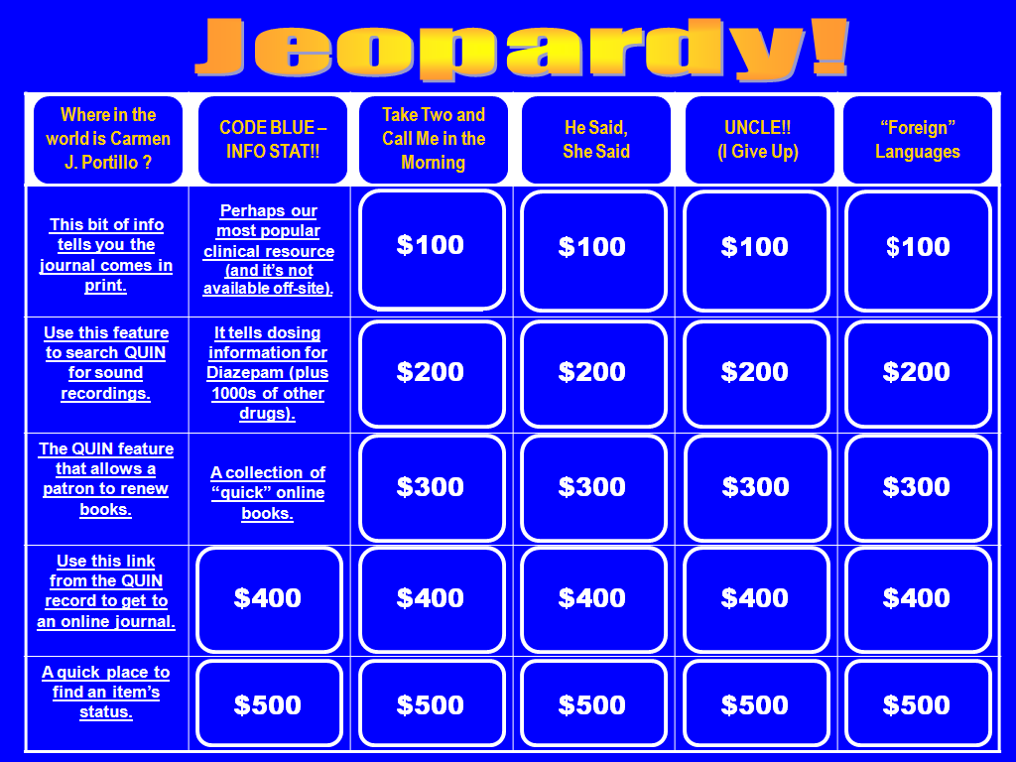
Web Resources
LSL Quiz Show
Notes:
1. Second class we offered was about web resources.
2. We wanted something more than pointing out recourses on the page –
Wanted to make it
Fun
Interesting
Make the students think – and maybe they will remember
SO – we created a Library Quiz show
It worked like a popular show you’ve all probably seen.
Code Blue – Info Stat!
Perhaps our most popular clinical resourse (and it’s not available off-site)
Up-TO-Date
Then the trainer would switch to our web page and actually show the resource.

Slide 35
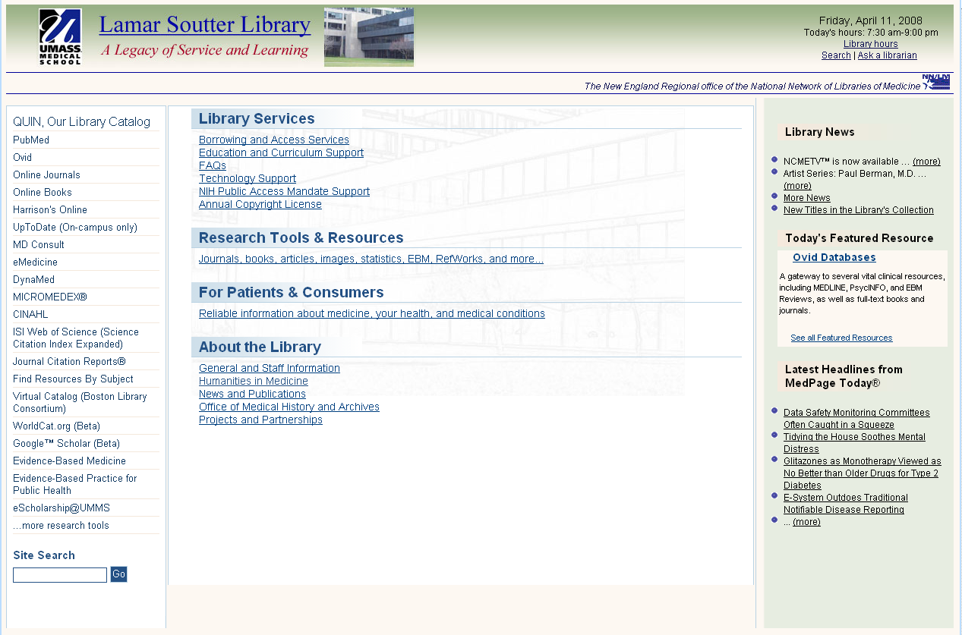
LSL Quiz Show
(a few tips to remember)
“Library hours” link tells up-to-date schedule
“One-A-Day” Database Vitamins
Use the featured resource as an easy reminder / tool to learn one new database each day.
Library Services
  Class information and online registration
Software on Workstations – quickly find what software is available on which PCs or Macs in the Library
ILL
Research Tools & Resources
  Complete list of databases
Online journals and books (incomplete lists – use QUIN to search entire collection)
Find Resources by Subjects (VERY handy!!)
EBM resources (Cochranes, Natural Standard,
News & Newspapers (LexisNexis, Mass Newstand, Facts on File, etc.)
Statistics (CDC Fast Stats, MassCHIP, Current Index to Statistics, etc.)
Patients & Consumers
  MedlinePlus
Go Local Massachusetts
eMental Health in Central Massachusetts
Lab Tests Online
Drug Information Portal
Quick Links:
Databases –
  PubMed
  Ovid (Medline, Cochrane, Biological Abstracts, HAPI, PsychINFO)
CINAHL
ISI Web of Science / Journal Citation Reports
Clinical Resources –
    UpToDate
eMedicine (images!)
DynaMed
MICROMEDEX
Online Catalogs –
    QUIN
WorldCat
Virtual Catalog
Others to remember:
    EBM Page
    eScholarship
© 2009 University of Massachusetts

Slide 36
Searching Pubmed and CINAHL
Make your Objectives Clear
HANDOUTS with screenshots
This training session will provide attendees with the following skills:
  Locating the resource
  Basic navigation
  Searching
  Understanding your results
Notes:
1. Third Class was
Formal training on two major databases with idea that feeling comfortable searching in these two major databases would help them explore others on their own and make them feel comfortable.
2. My tips to you are
Make your objectives clear (to students and to yourself)
Use handouts – something they can take away is soooo comforting to them.

Slide 37
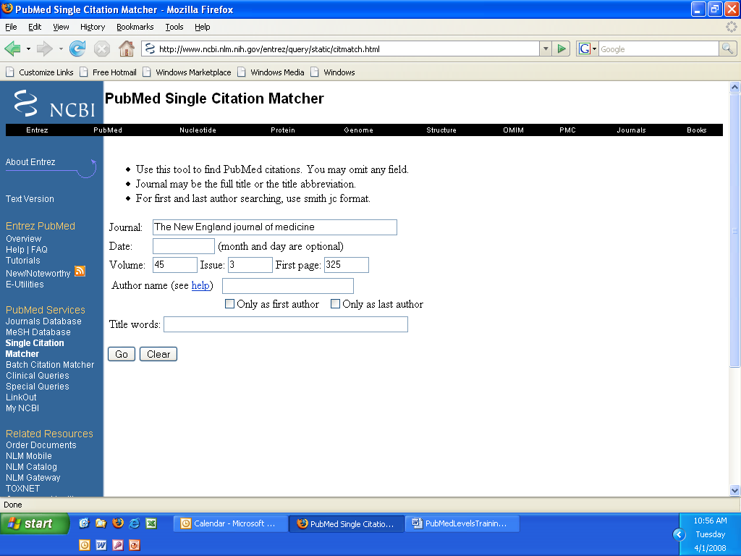
  Single Citation Matcher- to search for an article by its identifying information (such as author, journal title, article title, etc.), use this great tool!
This is where you input the identifying information to find the article.
Located in the Blue Tool Bar

Slide 38
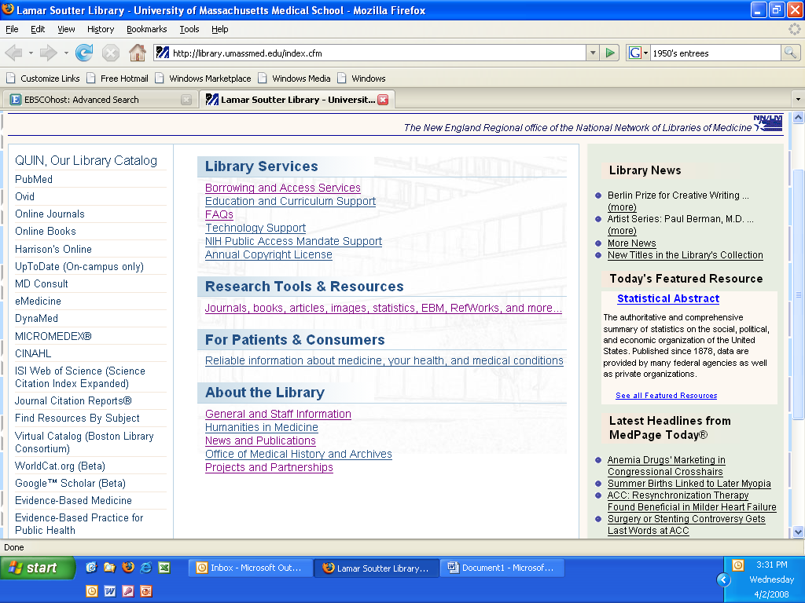
    CINAHL (Cumulative Index to Nursing & Allied Health Literature)
    This training session will provide attendees with the following skills:
    Locating the Resource
    Basic Navigation
    Searching
      Keyword
      Search Strategies
        And/Or
        Truncation
      Refine Search
      Basic Publications Search
      Basic Author Search
      Search History/Alerts
    Understanding Your Results
      Result List
      Citation
        Anatomy of a Citation Record
________________________________________________________________________
“I’ve never seen or used CINAHL before. Where do I begin?”
From the LSL homepage, click the blue link along the left side of the screen that says CINAHL.

Slide 39
Shadowing
One hour per week for 3 months.
Staff began to realize that librarians don’t know everything.
Hopefully that transfers to:
“Maybe I DON’T need to know everything!”
Notes:
1. Second type of training that we did was shadowing.
2. WHY:
Well of course is was important for staff to observe and learn from the librarians in action. But I had an ulterior motive.
3. …. this is where we addressed the apprehension of the support staff that I talked about earlier. Their fear was – How can I learn everything that the librarians know?
4. Staff were scheduled one hour per week to be on the reference desk with a librarian.
5. And they got to see librarians working with patrons – conducting reference interviews – and trying a variety of different sources and approaches to get to what was needed. The librarians didn’t always have an IMMEDIATE ANSWER.
6. The point I was constantly trying to make was: You don’t have to know everything! You can’t know everything! The librarians don’t know everything. That was the lesson I hoped they would take away from the experience.
7. Reverse shadowing – libs shadowed the circ staff at the circ desk. This was a chance for the support staff to “drive” with the librarian there as support.

Slide 40
Hands-On
Five reference questions/wk for 12 weeks
Advantages
  Actually had to look for resources and use them
  Doing helps you retain knowledge
Assumptions
  We gave Staff “off duty” time to work on assignments
Notes:
1. The third type of training we did was HANDS-on.
2. The reference librarians developed 5 questions per week for a period of 12 weeks. Staff were expected to use the resources at LSL to answer the questions, and then bring their work to their next “shadowing” slot to discuss with the librarian.
3. This training was extremely effective because staff actually had to look for resources and use them and as we all know – doing helps you retain knowledge.
4. For this to work, supervisors agreed to give staff “off-duty” time to work on their assignment.
Sample questions …..

Slide 41
Sample Questions
1. Where would you direct a patron who wants to see what our online resources are (journals, books, databases, internet links, etc.) in the area of Geriatrics?
2. Does the library subscribe to the Community of Science (COS) Funding Opportunities database?
[Once you find the database, try a search to see how the results are displayed and what information is provided. Just for fun, try the Search Wizard to the right of the search box. See if you can find some funding that would support your research on diabetes. ]
3. What are five resources you could suggest to a patient or family member to find information about heart attacks?
4. Do we have online access to the ICD-9 CM? If so, is it a current edition? Do we have it in print? What does ICD-9 CM mean?
5. Where would you find some basic history about the Worcester Foundation for Biomedical Research and the types of materials the Foundation has donated to the UMMS Archives ?
Notes:
These were the questions for week one.
Over the 12 week period the questions covered a wide range of topics -- and were a good sampling of what one could expect at a public desk in a medical library.

Slide 42
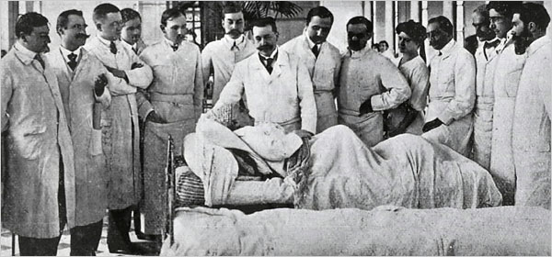
Ongoing Training
Library Grand Rounds
National Library of Congress
Notes:
1. Our fourth type of training is our on-going training …. And we call it Library Grand Rounds.
2. Grand rounds are a ritual of medical education, consisting of presenting the medical problems and treatment of a particular patient to an audience consisting of doctors, residents, and medical students. – so we thought the name was appropriate.
3. Once per month
4. All librarians and support staff meet
5. 2 staff responsible for the meeting -- bring interesting questions that happened at the desk
6. Librarians not in charge
7. Was designed to encourage communication between the two groups --- and it really has worked. The lines of communication have been flowing much more smoothly since the training and the grand rounds.

Slide 43
Evaluation
Notes:
Evaluation method used was a written test consisting of 31 questions and covering all the aspects of the ready reference training.
Not only did the test results tell us that the students had learned what we wanted them to learn,
But it was a good confidence booster for the staff who too k the test and were successful..
They could see that they were proficient ….

Slide 44
In Conclusion
Cross-Training has been Successful
  Staffing resources flexible
  One staff promotion the first year
Successful implementation of Single Service Desk
Triage is working
Notes:
Cross training was successful
Staffing resources are flexible
One promotion the first year – two more coming by Dec.
Successful implementation of SSD
Triage is working

Slide 45
Next Steps
Evaluation of the training program
Evaluation of the single service point
Reviewing and revising program elements
Notes:
SO – what are our next steps:
Evaluation of the training program and the SSD
Reviewing and revising the Career ladder program elements. – training – frameworks – areas of responsibility.
AND – before we go on to questions from the audience,
I’d like to mention that if you are interested in the whole career ladder program we developed at LSL,
Elaine Martin and I wrote an article about the development process of the program . The article was just published in the J. Of Academic Librarianship – v35 #4 475-481
“One model for creating a career ladder for library support staff.”

Slide 46
Information concerning the Career Ladder Program mentioned on slide # 4 may be found in:
Jane Fama and Elaine Martin. “One Model for Creating a Career Ladder for Library Support Staff.” The Journal of Academic Librarianship 35, no. 5 (2009): 475-481.

Slide 47
We welcome your comments, questions, and suggestions!
Our contact information:
  Jane Fama
    Jane.Fama@umassmed.edu
    508-856-2099
  Barbara Ingrassia
    Barbara.Ingrassia@umassmed.edu
    508-856-1041
The Lamar Soutter Library
University of Massachusetts Medical School
  http://library.umassmed.edu

Slide 48
Copyright Notice
All original content in this presentation is the intellectual property of the University of Massachusetts. Requests for permission for use of content for any other purpose should be directed to:
Barbara.ingrassia@umassmed.edu
Third party content included on this web site is in the public domain, or is used in accordance with the fair use doctrine, or used by permission. In all such cases, attribution of third party content is made. Requests for permission for uses of third party content should be directed to the copyright holder.

