Slide 1

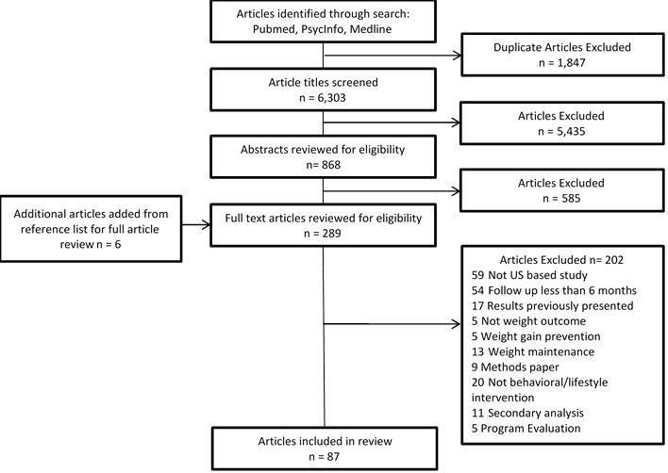
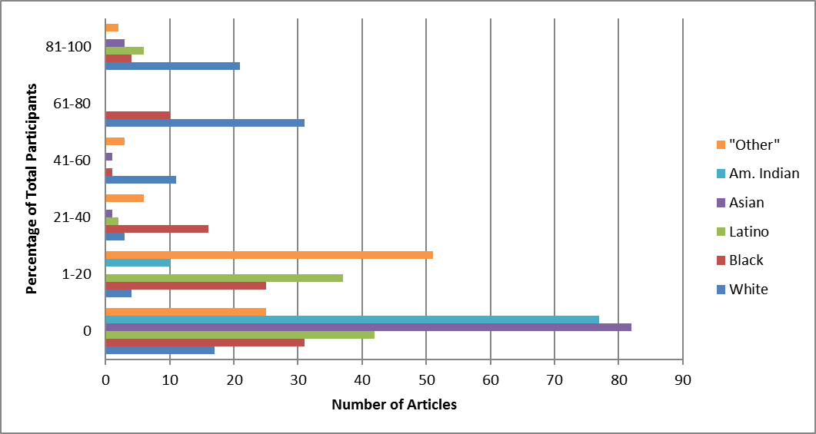
Racial/Ethnic Representation in Lifestyle Weight Loss Intervention Studies
in the United States: A Systematic Review
Christina F. Haughton, MPH, Valerie J. Silfee, PhD, Monica L. Wang, ScD, David P. Estabrook, Andrea C. Lopez,
Christine F. Frisard, MS, Milagros C. Rosal, PhD, Sherry L. Pagoto, PhD, Stephenie C. Lemon, PhD
Introduction
Methods
Obesity remains a persistent public health and health disparity concern in the United States and eliminating health disparities, particularly among racial/ethnic minority groups, is a major health priority in the US.
The NIH Revitalization Act and Federal Law in 1993 required that racial/ethnic minority groups be included in human subject research studies as appropriate for the proposed goals and aims of the study. Despite this effort for inclusion, underrepresentation of minorities in research has been documented.
Recent examinations of racial/ethnic representation in behavioral weight loss trials are lacking. Describing racial/ethnic minority inclusion in contemporary behavioral weight loss studies is critical to our understanding of the relevance of current weight loss research to diverse populations, particularly those who disproportionately experience high burdens of obesity.
Search Strategy
January 1, 2009 and December 31, 2015
PUBMED, MEDLINE and PSYCHINFO search engines were used.
Search terms: “weight”, “loss”, “overweight”, “obese”, “intervention”, “trial”
The reference lists of studies that met inclusion criteria were also searched
Inclusion and Exclusion Criteria
Inclusion criteria: (1) measured weight loss as a primary or secondary outcome, (2) implementation and evaluation of a behavioral intervention for weight loss, (3) study samples comprised of adult participants (≥ 18 years) who were non-hospitalized and non-institutionalized, (4) studies had a follow-up of 6 months or longer, (5) publication in peer-reviewed journal between January 1, 2009 and December 31, 2015 and (6) studies were conducted in the U.S.
Exclusion criteria: (1) evaluation of a pharmacological or surgical intervention, environmental or policy intervention only (2) basic science study of prescribed dietary meals or exercise, (3) study focused on program evaluation, (4) study focused on survey development, (5) study aim was weight maintenance or weight gain prevention, and (6) study aim was to conduct a secondary/mediation analysis of a trial.
Article Review Process
Two authors reviewed titles and abstracts to determine articles for full review
A systematic coding tool and protocol was developed and pre-tested
Each article was reviewed by two reviewers, inter-rater reliability was calculated
Coding Criteria
Race/Ethnicity Categories: (IRA=100%);
Study Design and Recruitment Strategies to Enhance Racial and Ethnic Minority Group Participation: (IRA=89.7%);
Race/Ethnicity Sub-Group Analysis: (IRA=96.6%);
Study Characteristics: Behavioral Target(s) (IRA=96.5%), Intervention Setting (IRA=86.0%), Study Location (IRA= 98.9%), Intervention Format (IRA = 95.4%).
Analysis
Measurement methods of race/ethnicity and the number of racial/ethnic categories reported in each study were described.
The percent of the sample for each racial/ethnic group was determined within each study and descriptive statistics were calculated to describe the distribution.
Recruitment approaches to include a diverse sample and the extent to which the studies included additional analyses by race/ethnicity were described narratively.
Study Aims
The primary aim of this review was to evaluate representation of racial/ethnic sub-group members in behavioral weight loss interventions conducted among adults in the United States.
The secondary aims were to assess recruitment and study design approaches to include racial/ethnic groups and the extent of racial/ethnic sub-group analyses conducted in these studies.
Flow Chart
Results
  Number of articles that reported specific racial/ethnic categories and the percent of the total sample of each category represented in behavioral weight loss intervention studies in the United States between 2009-2015 (n=87).
  Boxplots of distributions of racial/ethnic categories among behavioral weight loss interventions in the United States 2009-2015 (n=87).
  Number and percentage of participants by racial/ethnic category in behavioral weight loss interventions in the United States 2009-2015 across the 87 included studies.
The majority of the 87 studies included a majority of White participants compared to any other racial/ethnic group.
The racial/ethnic categories used to describe the sample varied. The number of categories ranged from a single racial/ethnic group to six different groups.
The “other” racial/ethnic category was used in a total of 62 of the 87 studies.
Thirty-six of the 87 studies (41.4%) reported an intention to recruit a diverse sample and/or described targeted recruitment approaches.
 | n | %
White | 16,629 | 61.0%
Black/African American | 4,924 | 18.0%
Latino/Hispanic | 2481 | 9.1%
Asian | 561 | 2.0%
American Indian | 295 | 1.1%
Other | 2,133 | 7.8%
Conclusions
Lack of adequate representation of racial and ethnic minority populations in behavioral trials limits the generalizability and potential public health impact of these interventions to groups that might most benefit from weight loss.
Given racial/ethnic disparities in obesity rates and the burden of obesity and obesity-related diseases among minority groups in the United States, greater inclusion in weight loss intervention studies is warranted.

