Slide 1


Using Cases to Teach Research
Data Management
New England Collaborative Data Management Curriculum
Donna Kafel, MLIS
Lamar Soutter Library
UMass Medical School
This work is licensed under a Creative Commons Attribution-ShareAlike 3.0 Unported License.

Slide 2
New England Collaborative Data Management Curriculum
Selecting a Case
Discipline
Research setting (e. g. clinic, lab)
Specific data management concept or issue

Slide 3
New England Collaborative Data Management Curriculum
Cases
Clinical Health Study:
  Outcomes from Orthopedic Implant Surgery
  Studying Vitamin D as an Augmentation of Treatment for Bipolar Depression
Health Study in lab:
  Combining Data from 10 Years of Research for Retrospective Studies on the Effects of Exercise and Diet on the Risk of Diabetes

Slide 4
New England Collaborative Data Management Curriculum
Cases (cont’d)
Biomedical lab:
  Regeneration of Functional Heart Tissue in Rats
Qualitative Behavioral Health Study:
  Improving End of Life Care in African Americans
Engineering Test Lab:
  Characterizing a Component of a Rocket Engine Used to Control Satellites in Orbit

Slide 5
New England Collaborative Data Management Curriculum
How to teach RDM using cases
Summary of teaching points preceding each case
Discussion questions following each case
Research Data Management Concepts and Issues Illustrated in the Teaching Cases
Integrated as activities in lesson plans
Notes:
Each of the research cases in the curriculum are real. They have been written by our curriculum project partners.. Who had interviewed researchers—asking them to describe an actual project and how data is managed in the course of the project. Taking their responses, our partners wrote these cases. The assortment of cases we have so far illustrate data management activities and issues in different disciplines and in different research settings. These cases enable students to visualize data management in the context of a familiar research environment.
During the planning phase of the project, we interviewed faculty from UMMS and WPI to ask them how their students were currently managing their data, and to get suggestions from them as to how we could build a curriculum that would teach generic data management and address data management issues unique to disciplines. Each faculty emphasized that data and research practices vary widely from one field to another, (adding also from one lab to another, even within the same discipline)—and that using teaching cases would address data management issues unique to specific disciplines and provide students with a familiar context.
In Module 1, in the lesson plan, for the assessment you will see “Read excerpt from research data case “Outcomes of Orthopedic Implant surgery” that illustrates the challenges in conducting a multiyear study with changing personnel. An activity for Module 3, “contextual details needed to make data meaningful to others” is “Using a research case, identify the basic project information.

Slide 6
Case Analysis using Simplified Data Management Plan
Types of data
Contextual details (metadata) needed to make data meaningful to
others
Storage, Backup, and Security
Provisions for Protection/Privacy
Policies for re-use
Policies for access and sharing
Plan for archiving and preservation of access

Slide 7
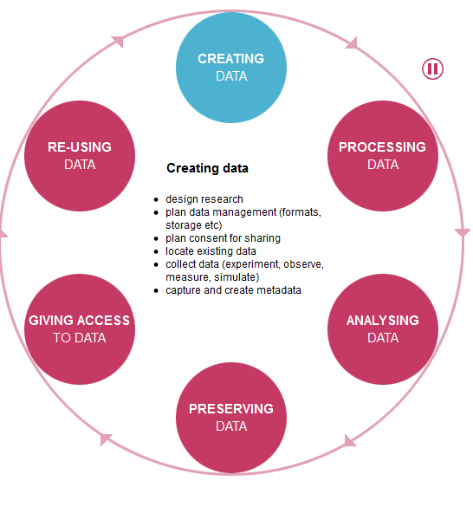
UK Data Archive Research Data Lifecycle
http://www.data-archive.ac.uk/create-manage/life-cycle
Notes:
Review the different stages of the research data lifecycle: impress upon students that Case B really only addresses creating data--

Slide 8
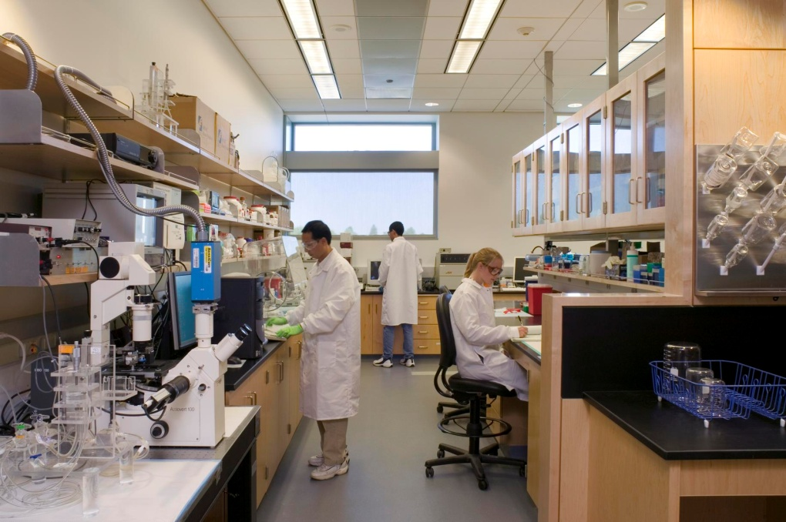
Regeneration of functional heart tissue with stem cell delivery
A data management case study in biomedical engineering research
Image courtesy of UC Davis College of Engineering

Slide 9
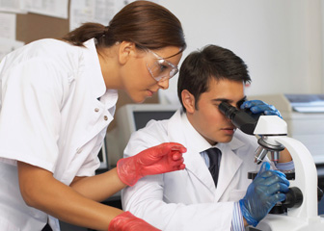
Biomedical Engineering
Photo from Bureau of Labor Statistics.
“Advances knowledge in engineering, biology, and medicine, and improves human health through cross-disciplinary activities that integrate principles of engineering sciences with medical sciences and clinical practice.”³
³Imperial College London. N.D.
http://www3.imperial.ac.uk/pls/portallive/docs/1/51182.PDF
Notes:
Biomedical engineering is currently the fastest growing field of engineering—as this definition states, biomedical engineering uses principles of engineering sciences with medical sciences and clinical practice to develop new medical devices and processes that improve medical practice and advance the quality of life.

Slide 10
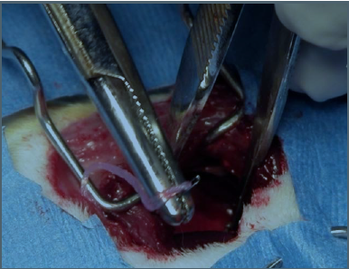
Experiment: delivery of stem cells on a biological fibrin microthread to areas of damaged heart tissue in one rat’s heart
Purpose: to restore mechanical function of damaged heart tissue
Image courtesy of Dr. Glenn R. Gaudette
Notes:
The experiment depicted in this case is the delivery of stem cells on a fibrin microthread to areas of damaged tissue in a rat’s heart.
The ultimate purpose is to restore mechanical function of the damaged heart tissue by seeding stem cells that will differentiate into cardiac muscle cells and restore function to areas of heart tissue.
What type of research would you describe this case?
Simulation
Observational
Experimental
Derived
Yes it is experimental—and most of the key data sets such as the images and the left ventricular pressure measurements are generated from lab equipment

Slide 11
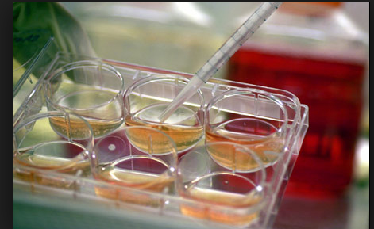
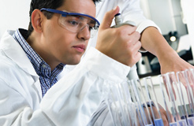
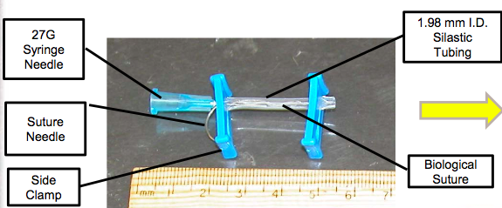
Materials used in Experiment
SDMP
# 1
creating
data
Photo courtesy of nlm.nih.gov
Photo courtesy of Dr. Glenn R. Gaudette
Notes:
Before the actual experimentation even begins,and experimental data is generated, there is contextual data that needs to be recorded. This can include the names of the PI and themembers of the research team and what their designated tasks are in the project, an identifier for the experiment (e.g Experiment # 24) . In this particular case, the stem cells need to be identified (from what stem cell line are they), where were they bought, what solutions/ cell markers are being used, what laboratory equipment, (serial numbers of instrumentation), details about the syringe via which the stem cells are delivered.
This type of information is recorded in a lab notebook. In this case, the lab uses a paper lab notebook.

Slide 12
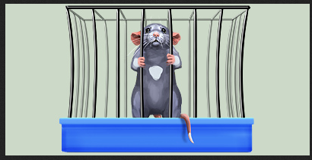
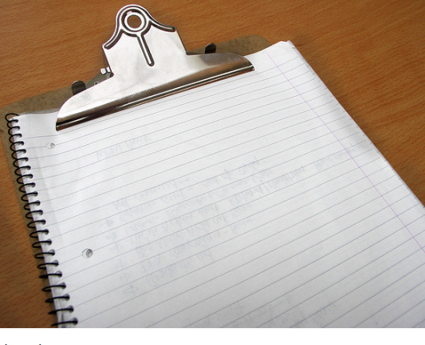
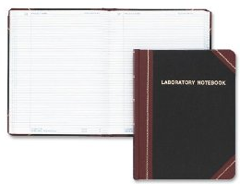
Animal Model for Experiment: Rat
SDMP
# 1
creating
data
SDMP
# 2
File formats
Surgical log for #2345
Notes:
What about data related to the subject of the experiment, the rat? What the case does tell us is that a surgical log is kept next to his cage. All information from the surgical log needs to be transcribed in the lab notebook,
The rat is given an identifier, such as a number. This, along with his/her age, sex, specifics on breed, vital signs are recorded in both the surgical animal log which is always kept by his cage, and also in the paper lab notebook. As noted in the case, everything that is entered into the surgical log, needs to be transcribed in the paper lab notebook.

Slide 13
Timeline of Experiment:
SDMP #1
Creating
data
-2 days: Incubate stem cells with markers
7 day: #2 Surgery: examination, high speed imaging/LVPs, isolate heart and place it in freezer
8 days +: Section heart, tissues on slides, staining, images of tissues, tracking particles on heart
Collective data from experiment
-1 day: Stem cells in solution with biological suture
0 day: #1 Surgery: infarct/delivery of stem cells to damaged heart tissue
Notes:
This timeline provides a chronological table of the multiple steps in the experiment that generated data.
When you’re reviewing a research case in which there are multiple types of data that have been created—you may find it helpful to sketch a timeline that notes what data was created at what time in the project—this timeline helps you to breakdown the experiment in stages to get a broader picture of the data generated.

Slide 14
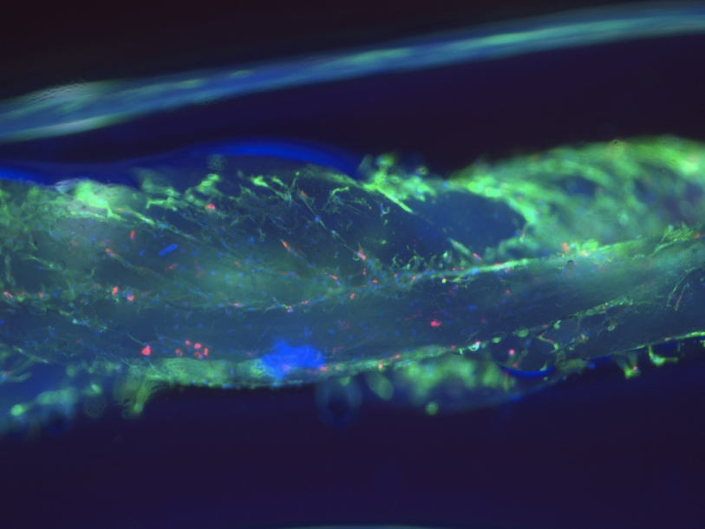
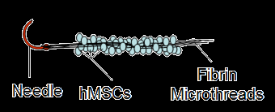
Timeline of Experiment
SDMP #1
Creating
data
2 days before surgery
1 day before surgery
Incubate adult stem cells with markers (Q dots)
Place stem cells in solution—inject into tube with biological suture
Images courtesy of Dr. Glenn R. Gaudette
Notes:
Tube identifier: Lot # for stem cells (come from vendor)
Imaging to confirm Q dot loading
Solution
Biological suture—gauge, width, where it was made, what it is made of
Imaging to make sure the stem cells adhere to the suture
Names of the members of the research team involved in this activity

Slide 15
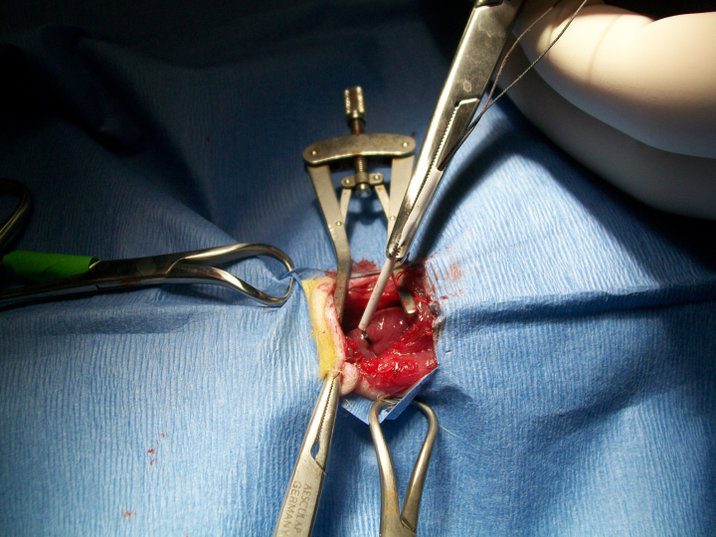
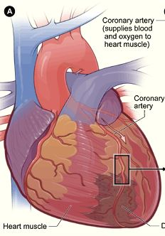
Timeline of Experiment
1. Document pre-op data
2. Operative procedure: open up thoracic cavity.
  Create a myocardial infarction
  b. Place biological suture with stem cells in area of infarct (damaged heart tissue)→document operative data
Day of Surgery
DMP #1
Creating
data
DMP #4
Ethical
issues
Image courtesy of Dr. Glenn R. Gaudette
Notes:
What data do you think would be documented during this first day of surgery?
Rat: identifier (number), age, weight, sex, health, vital signs
Names of team members present on the experiment and their roles
Timing of events: delivery of anesthesia, opening of thoracic cavity, time the myocardial infarction is initiated and the time that the artery is kept occluded—-
Time the biological suture is threaded through the infarcted region—and the location of the heart where that infarcted region is located.
Time thoracic cavity was closed and surgery completed.
Post-op data:
Rat’s vital signs, behavior, assessment and treatment of pain—documentation of data related to the animal’s level of pain and any treatments to relieve the animal’s pain are required by Institutional Animal Care committees.
Where is this data kept? (lab notebook, animal’s surgical log)

Slide 16
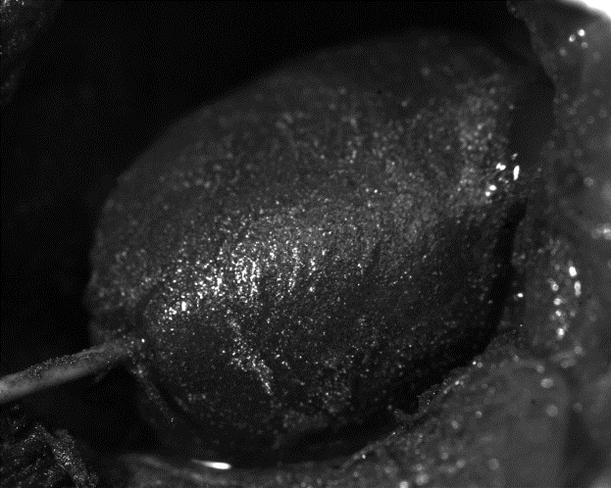
Timeline of Experiment
DMP #1
Creating
Data
7 Days Post Stem Cell Delivery: 2nd surgery
Thoracic cavity is reopened
Images of heart are collected with 2 cameras
Pressure transducer syncs with images—measures left ventricular pressure
Euthanize rat
Isolate heart and fix it in a fixative
Put in freezer 24 hrs.
DMP #2
Formats,
Naming
DMP #3
Storage
Image courtesy of Dr. Glenn R. Gaudette
Notes:
Once again all operative data is collected and noted in paper lab notebook and animal’s surgical log
The team is collecting new types of data now: images of the heart, measures of the left ventricular pressure
The instruments that are being used are 2 cameras that work as a system, and a pressure transducer that measures ventricular pressure in the left ventricle
As this image data is being collected, how is it stored?

Slide 17
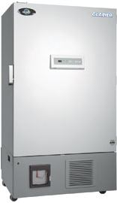
SDMP #1
Types
of data
Timeline of Experiment
24 hours after placement of heart in freezer:
Sectioning heart tissue
Cutting sections of heart and placing on slides.
(Yield ~200 slides per experiment)
2. Tissues are kept in 3 freezers.
SDMP #2
Contextual
Data
SDMP #3
Storage.
Security
Notes:
Sections of the heart tissue—slides need to be labeled. Area of heart from which sections were taken.
Tissues are kept in three freezers (one for sectioned tissue placed on slides, one for embedded but not yet sectioned tissue, and “other” tissue kept in a container “may be” placed in yet another freezer.
Delegate what freezer is meant for storage of sectioned tissue, embedded but not sectioned tissue, and other tissue.
Document what was done, which team members sectioned heart and placed tissue on slides, date,
staining

Slide 18
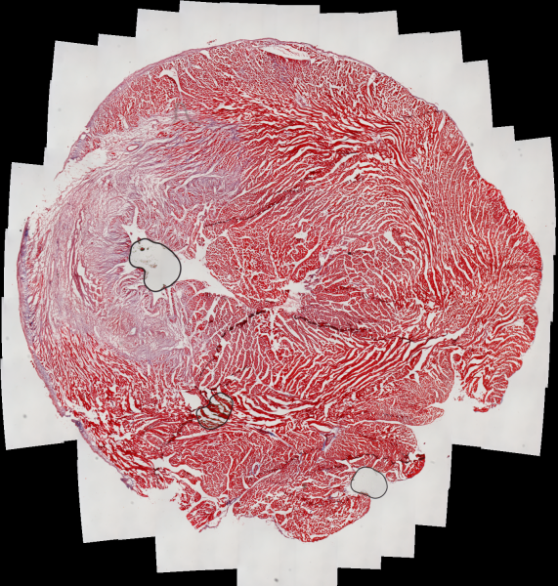
Timeline of Experiment
8+ Days: (up to “a couple” months):
SDMP #1
Creating
Data
Some of the slides are stained immediately
Other slides stained from a day to a couple of months after that
Stains: some are stained with trichrome, some other stains for specific markers
SDMP#2
Contextual
Details
~200 slides
SDMP #3
Storage
Image courtesy of Dr. Glenn R. Gaudette
Notes:
Some tissue slides are stained with one type of stain such as trichrome, others are stained with actinin, and yet others are stained with other stains. . There are different stains used such as trichrome and actinin staining on the tissues on the slides. Some stains like the trichrome show what tissues is dead. Other stains show the specific markers that show where the stem cells are in that cross-section.
This generates new data that needs to be recorded—the slides need to be labeled with the experiment number, section of heart (A or B) and the stain that was used.
These slides are kept in slide boxes and stored in one of the three freezers.

Slide 19
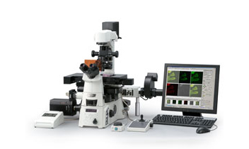
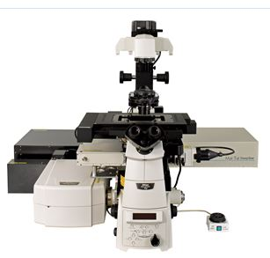
Timeline of Experiment
Unspecified but after several slides are stained: Taking microscopic images of stained slides
SDMP #3
Storage
Security
Take images on lab’s epifluorescent microscope
SDMP #1
Creating
data
If happy with staining, use confocal microscope to take better quality images
SDMP #2
File formats
Naming
conventions
Notes:
At this point several slides have been stained. Images of the stained slides are taken on the epifluorescent microscope. If “we are happy” with the staining and the way they look, they make an appointment to use the confocal microscope which takes much better quality pictures and they take those images on the confocal.
How should the images of the stained tissues be labelled?
Where are the slides of the stained tissue kept? Are the slides that are stained with one particular stain kept together?
What is the file format for the images from the microscope? Is it proprietary? Preservation concerns: Can it be changed to an open format that is more generic so that others can view the images without needing proprietary software and to avoid running into a situation where the file formats are obsolete and can no longer be rendered.

Slide 20
At the same time….
Team looks at the data that they acquired and use home-grown software to track particles on the surface of the heart to see how far and how fast those particles are moving.
SDMP #4
Ownership
SDMP #1
Creating
data
SDMP #3
Storage
Notes:
So the research team develops home-grown custom software to track particles on the surface of the heart. This software was written in C and MATLAB, and is used to analyze the optical images of the heart—telling them what the function is like in that region of the heart. This is done for several heartbeats in different data sets.
So what type of data is generated by this software?
The software itself is data critical to the project—what use is it after the project is completed?
Various members of the research team create the software—who owns it?

Slide 21
File Formats
Data | File Format
Images | ?
Left ventricular pressure measurements | ?
Home made software | MATLAB or C
Histology sections | Slides—file name based on stain—example .act is actinin stain
Contextual | Paper lab notebook, animal log
SDMP #3
Storage
SDMP #2
File
formats
SDMP #4
Ownership
Directory that links data sets together: Excel spread sheet
Notes:
File formats for the images and for numeric measurements: not mentioned in the case study

Slide 22
Analyzing the data
“There could easily be up to 10 people involved in data analysis and we have not yet found a good way to link all the data.”
Dr. Glenn R. Gaudette, PI
Notes:
There are easily up to 10 people involved in analyzing the data of the experiment. One might be analyzing the mechanical function of the heart, one may be analyzing trichrome staining, one may be analyzing images.
The data sets are all linked together on an Excel spread sheet.
Biggest challenge is tissue sections that are on conventional slides.

Slide 23
SDMP #3
Storage,
Backup,
Security
Data Set | Storage
Optical images taken during Surgery: (~10,000 images) 1000 images for each data set | Hard drive acquisition computer > Drobo backup>hard drive of network computer backed up by institution
Left ventricular pressures (numeric) correlating with specific images | Same as above
Tissue sections | Slide boxes—could be in any of 3 or 4 freezers
Software | ?
Images from different stained tissue after second surgery | Drobo > DVD backups
Contextual data | Paper lab notebook (lab, PI’s office), surgical log (with animal)
Notes:
The various storage places between the digital files, the slides, and the paper lab notebook and surgical log make it difficult to easily access, integrate, and analyze the various data outputs from the experiment.
Moreover, look at the security issues. “we back the data sets on an external hard drive someplace” ---where?
Files are not password protected. The lab notebook is either in the PI’s office or most often in the lab, which has key card access.

Slide 24
DMP #4
Ethical
issues
SDMP #6
Policies for
Access and
sharing
SDMP #7
Plan for archiving
& preservation
of access
SDMP #5
Policies
for reuse
What are the policies for reuse of data?
What is the process for gaining access to data?
What is the long term plan for preservation and maintenance of the data?
Notes:
Privacy issues
IACUC Institutional Animal Care and Use Committee
Ownership of data: images, LVP readings, tissues, animal surgical log, paper lab notebook, software
Documentation for patent application
The case doesn’t mention policies for re-use anywhere. Will there need to be de-identified copy of the data?
What concerns do you think the PI would have in terms of data reuse?
What strategies should be considered for long term preservation of the data?
How is the data appraised—what is considered a final version—how is the data appraised and selected for long term preservation?
Preservation concerns: Can data formats that are proprietary, such as the left ventricular pressure readings generated by the pressure transducer be changed to an open format that is more generic so that others can view the images without needing proprietary software and to avoid running into a situation where the file formats are obsolete and can no longer be rendered.

Slide 25
Case B Analysis using Simplified Data Management Plan
Types of data: Images of heart, LVP measurements, histology slides (tissues), images of slides, software
Contextual details (metadata) needed to make data
meaningful to others:
experiment #
dates of experimental activities
stem cell line
details about animal (species, age, identifier)
area of infarct
area where stem cells implanted
type of stain used
instrumentation
3. Storage, Backup, and Security:
Hard drive of acquisition computer (initial)
Drobo
networked hard drive (backed up by institution)
DVDs
Slide boxes in freezers
Policies for access and sharing
Plan for archiving and preservation of access

Slide 26
Case B Analysis using Simplified Data Management Plan
3. (continued):
Lab notebooks/animal surgical logs (some backup when data is transcribed from animal surgical log to paper lab notebook)
Provisions for Protection/Privacy:
Files are not password protected
Paper lab notebooks are kept in lab/older ones in PI’s office (key card access to these rooms)
Policies for re-use:
Not addressed –need to ask researcher (possiblities: reuse with permission of PI, institutional policies)
Policies for access and sharing:
Not addressed—need to ask researcher (possibilities: PI will make accessible after paper publication, will share them immediately, may depend on funding agency reqs.
3.

Slide 27
Case B Analysis using Simplified Data Management Plan
Plan for archiving and preservation of access
Not addressed—ask researcher (possibilities: convert files in proprietary formats to generic formats, appraisal of data and data versions, decision on where data should be archived (IR or DR)

Slide 28
References
Gaudette, G. R. 2011. “Keeping a lab notebook in the Gaudette lab.”
Unpublished.
Gaudette, G. R. 2012. “Data management in biomedical engineering:
needs and implementation.” Power point presentation. University
of Massachusetts Medical School, Shrewsbury, MA 4 April 2012.
http://escholarship.umassmed.edu/escience_symposium/2012/program/9/
Gaudette,G.R. and Kafel, D. 2013. “ A case study: data management in
biomedical engineering.” Journal of eScience Librarianship: 1(3): 159-
172. http://dx.doi.org/10.7191/jeslib.2012.1027
Humphries, C. 2003. “e-Science and the lifecycle of research.”
Accessed March 19, 2013 at
datalib.library.ualberta.ca/~humphrey/lifecycle-. science060308
Imperial College London, Department of Engineering. N.D. “Definition of biomedical
engineering.” Accessed March 20, 2013 at
http://www3.imperial.ac.uk/pls/portallive/docs/1/51182.PDF
UK Data Archive. Research Data Lifecycle.
http://www.data- archive.ac.uk/create-manage/life-cycle

