Slide 1
Building the Future:
Rejecting
Rethinking
Redoing
Rejuvenating
Medical Librarianship
Martha Meacham – Library Fellow – @MarthaMeacham
Jane Fama – Associate Director
Elaine Martin – Director
Lamar Soutter Library at the University of Massachusetts Medical School

Slide 2
Rejecting what no longer works
The Perfect Storm
Budget Cuts
Rising Costs – journals, databases, etc.
Circulation
Library Trends
  Declining Statistics
  Library Work is Changing
    Embedded librarians
    Data management
    Expert searching
Avoid a slow death – changing bit by bit every time we have a cut
Difficult but necessary changes
Rejecting
Rethinking
Redoing
Rejuvenating

Slide 3
Rethinking Librarianship
Seeds of the Program
Total Reorganization
Changing needs of Profession
Library Fellow Program
What can be cut?
What do we really need?
Experience
New roles/service
All professional staff
Train new graduates
Build foundations and specialized skills
Rejecting
Rethinking
Redoing
Rejuvenating

Slide 4
Rethinking Librarianship
Seeds of the Program
Reference
Research
Curriculum
Database
Culture
Journal Club
Replace old Model
Full service, front line
Morning Report
2 years
Rotations
Research
Learning Objectives
MLA Competencies
Rejecting
Rethinking
Redoing
Rejuvenating

Slide 5
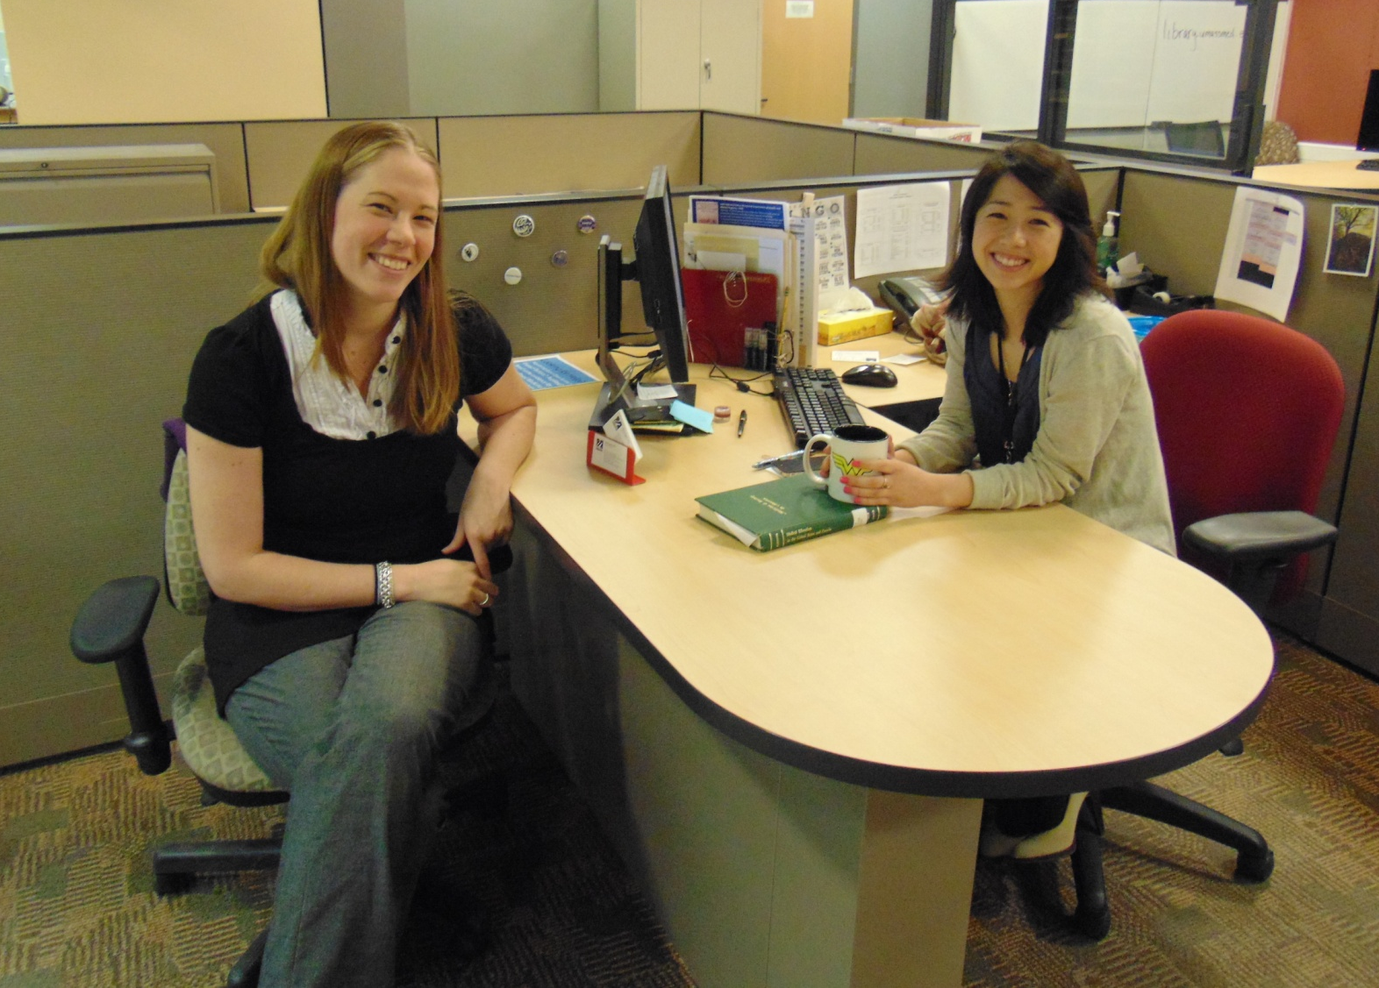
Redoing our Identity – Take Action
Let’s see what grows
The Fellows
Learning
through
experience
Expectations
Vs. Reality
Evaluation
Why a
Fellowship
A Work in Progress
Rejecting
Rethinking
Redoing
Rejuvenating

Slide 6
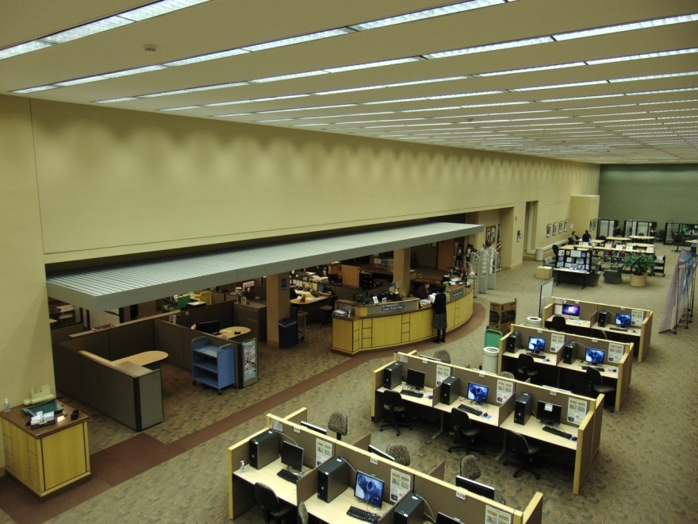
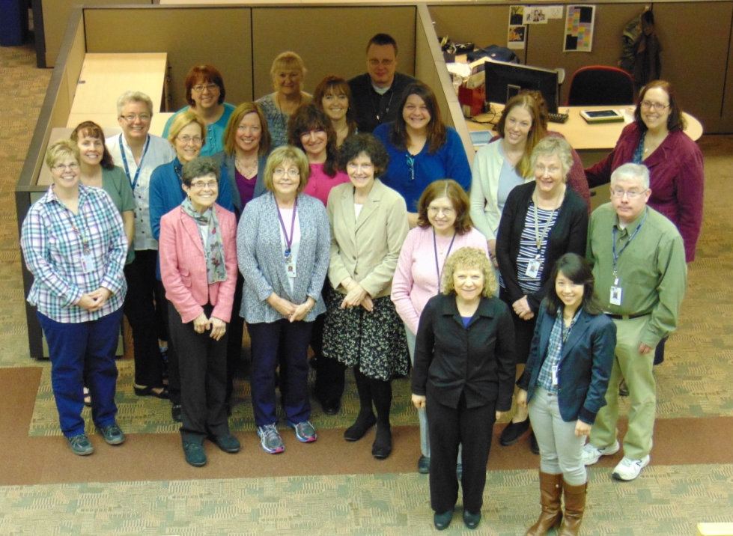
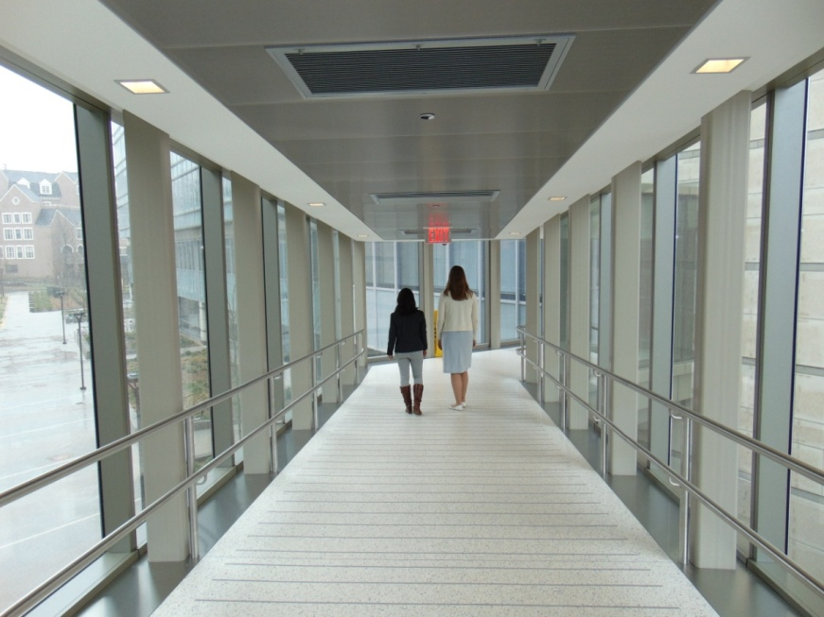
Rejuvenating our Library and Ourselves
Fruits of our Labor
Rejecting
Rethinking
Redoing
Rejuvenating

Slide 7
Thank you
Questions?
Martha Meacham – Library Fellow – martha.meacham@umassmed.edu
Jane Fama – Associate Director – jane.fama@umassmed.edu
Elaine Martin – Director – elaine.martin@umassmed.edu
Lamar Soutter Library at the University of Massachusetts Medical School
Rejecting
Rethinking
Redoing
Rejuvenating
Medical Librarianship

