Slide 1
Differences in Off-Campus Student Outcomes of Evidence Based Practice Searching Skills
Research Questions:
Is there a difference in quality of bibliography between synchronous off-campus students and in-person students? Is there a relationship between the quality of the students’ bibliographies and library use?
Electra Enslow
Health Sciences Librarian
Washington State University Spokane

Slide 2
Outcomes from IRDL
Submitted a Case Study for JMLA
2 new papers in the works
Submitted 2 proposals for MLA 2017

Slide 3

Create a Culture of
Research

Slide 4
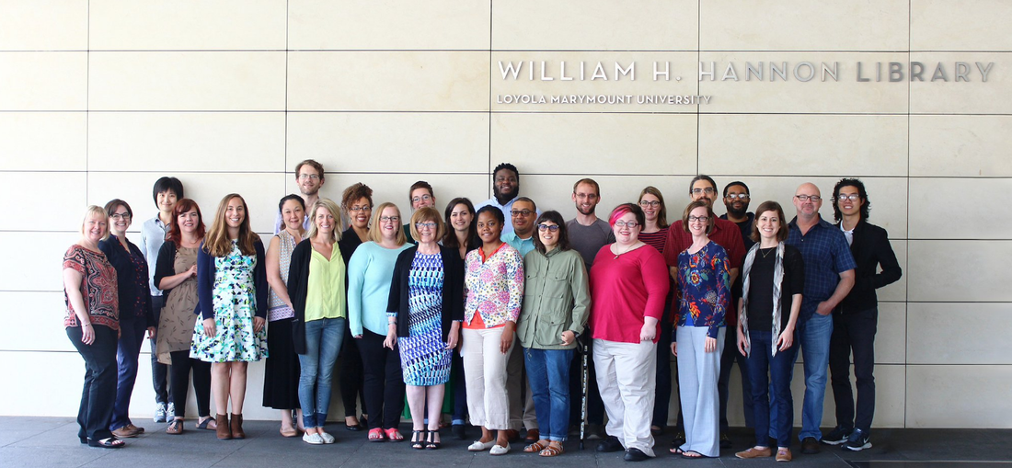
Tips
Proofread
Support
Simplicity
Time
Passion

